Slide 1


POLYNOMIAL ADT USING HEAP AND HASH CODE
19AIE111 :DATA STRUCTURES AND ALGORITHM

Slide 2
GROUP MEMBERS
Team 6
CB.EN.U4AIE19003 –Adhithan
CB.EN.U4AIE19023 – Mithil
CB.EN.U4AIE19024 – Dharshan Kumar
CB.EN.U4AIE19033 – Kabilan
CB.EN.U4AIE19061 – Sivamaran

Slide 3
COntents
Serial No | Topics
1 | Heap data Structure
2 | Program for given problem
3 | Additional methods

Slide 4
PROBLEM
Representing a single variable polynomial of any degree in a class using minheap to store powers. The polynomial class should be able to do operations such as multiply, add , subtract via methods. Also, one must be able to square and append the polynomial (modify the coefficients of a certain power term or add more terms. A ‘getDegree ‘method must be automatically computed. The ‘toString’ method should convert the polynomial into a String with increasing order of degrees.

Slide 5
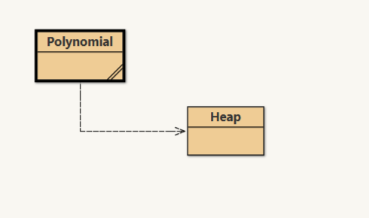
UML Diagram

Slide 6
ADT
Abstract data types are mathematical abstractions
This can be viewed as an extension of modular design.
Objects such as lists, sets, and graphs, along with their operations, can be viewed as abstract data types
A polynomial ADT is required to represent a polynomial. For the Polynomial ADT, there are various operations as addition, subtraction, multiplication, append etc.

Slide 7
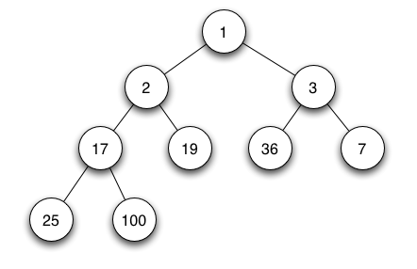
1
Heap Data Structure
Java Code

Slide 8
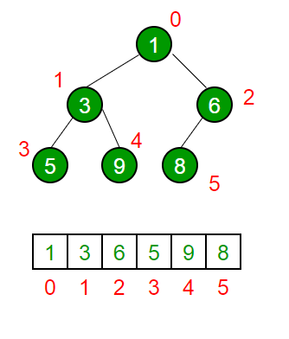
ADT MIN-HEAP
A binary heap is a complete binary tree which satisfies the heap ordering property.
The ordering of min-heap is such that the value of each node is greater than or equal to the value of its parent, with the minimum-value element at the root.
ADT min heap is useful in removing the object with the highest priority.
A common use of a heap is to implement a priority queue.

Slide 9
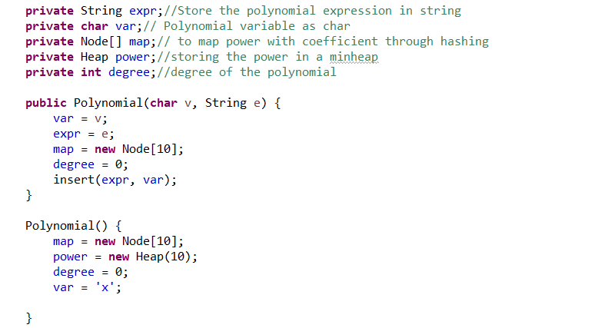
Instance variables and constructor

Slide 10
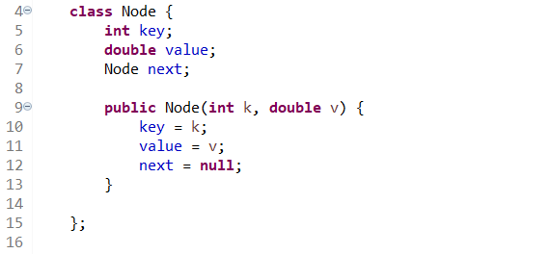
ADT NODE
Here we store the key-value pair with a linked list structure.

Slide 11

2
Solution for given
Problem
Java Code

Slide 12
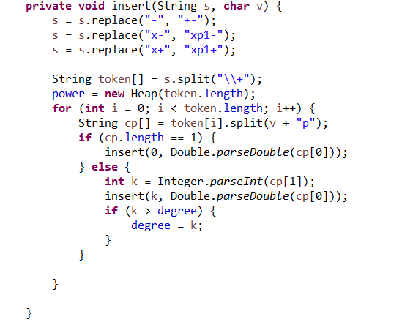
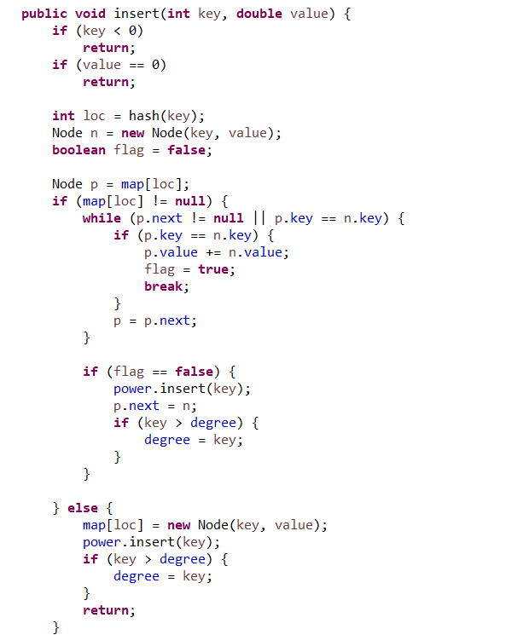
Methods-Insert

Slide 13
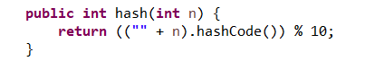
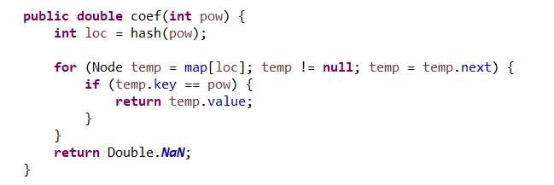
Hash
The key is hashed using the built-in hashCode() such that it is mapped to locations from 0-9 in array map.
Coefficient
It returns the corresponding coeffient for the given power of the term (key for the hash map).

Slide 14
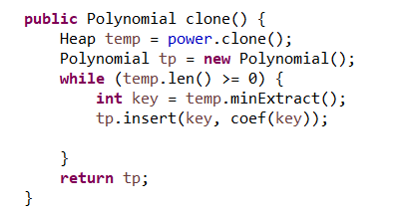
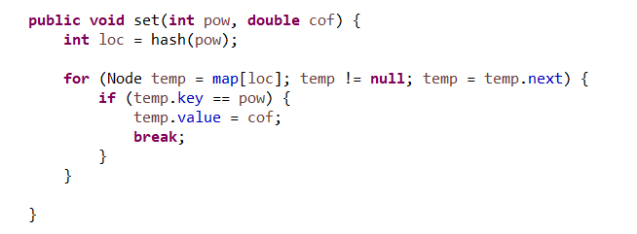
clone():
It is to create a duplicate of the given polynomial
It is done to avoid losing our original polynomial
set(int pow, double cof):
It modifies the coefficient of a term, when the power of term(key) is given

Slide 15
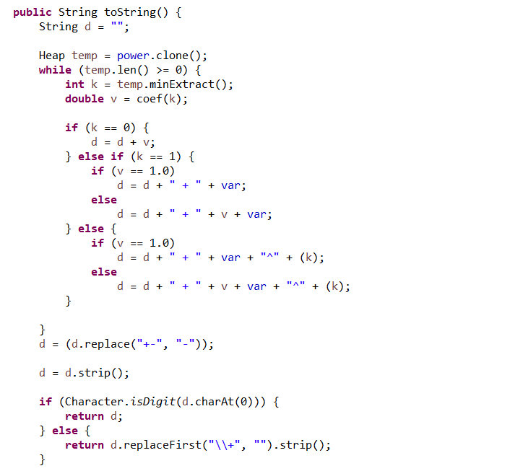
toString():
It converts the polynomial into a String with increasing order of degrees.

Slide 16
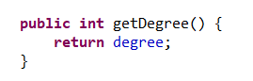
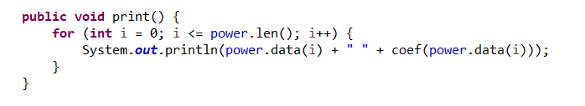
getDegree():
It return the degree of the polynomial.
print():
It print the power and the corresponding coefficient of all terms of the polynomial.

Slide 17
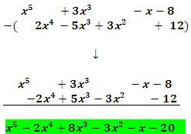
3
Additional Functions
Java Code

Slide 18
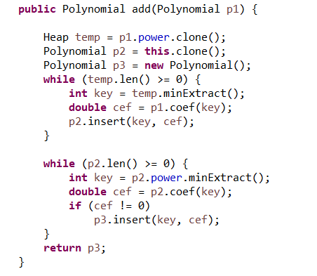
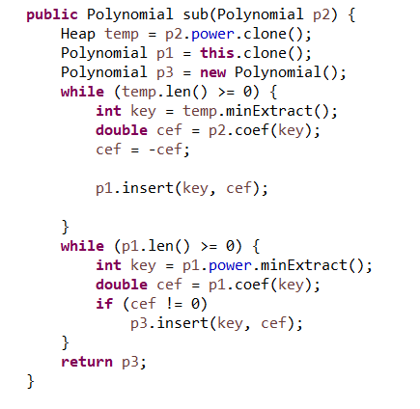
add(Polynomial p1):
subtract(Polynomial p2):
It adds two polynomials.
It subtracts two polynomials.

Slide 19
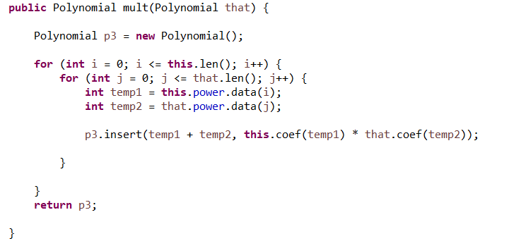
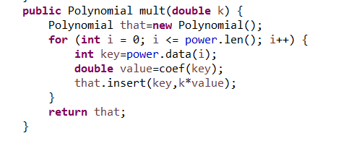
mult(Polynomial that):
mult(double d):
It multiplies two polynomials.
It multiplies the polynomial with a constant.

Slide 20
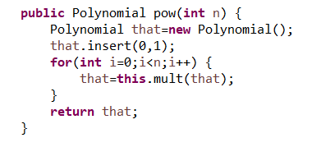
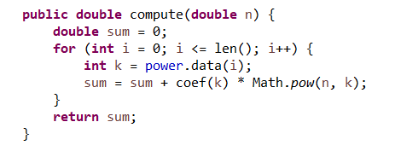
pow(int n):
It returns the polynomial raised to the power n(eg x²+x+1 return (x²+x+1)^{n})
compute(double n):
It computes the function value of the polynomial at point n.

Slide 21
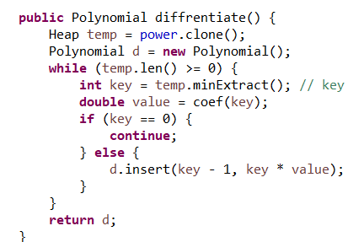
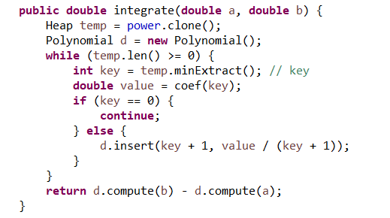
differentiate():
integrate(int key1, int key2):
It differentiates the polynomial with respect to the variable.
It integrates the polynomial with respect to the variable from a to b.

Slide 22
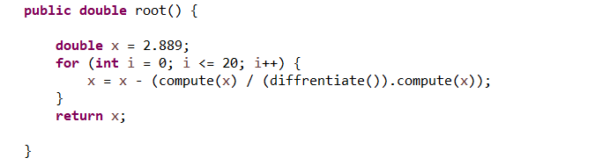
root()
It computes root of the polynomial.

Slide 23

Thank You
Presentation by Team 6

